Slide 1
When will AI take their jobs? Music transcription & transformer
Zhou Zelin
2021.4.21
Episode 2
Notes:
Hi everyone, I'm zelin. Today I'm gonna talk about "(title)", you can regard it as the second episode of what zhiling talked about last time :)

Slide 2
Outline
Introduction
Learning to record
Learning to compose
Conclusion
Notes:
This is the outline of this talk. I'll first introduce you with some background information, then go through two papers regarding music recording and composing.

Slide 3
Outline
Introduction
Learning to record
Learning to compose
Conclusion

Slide 4
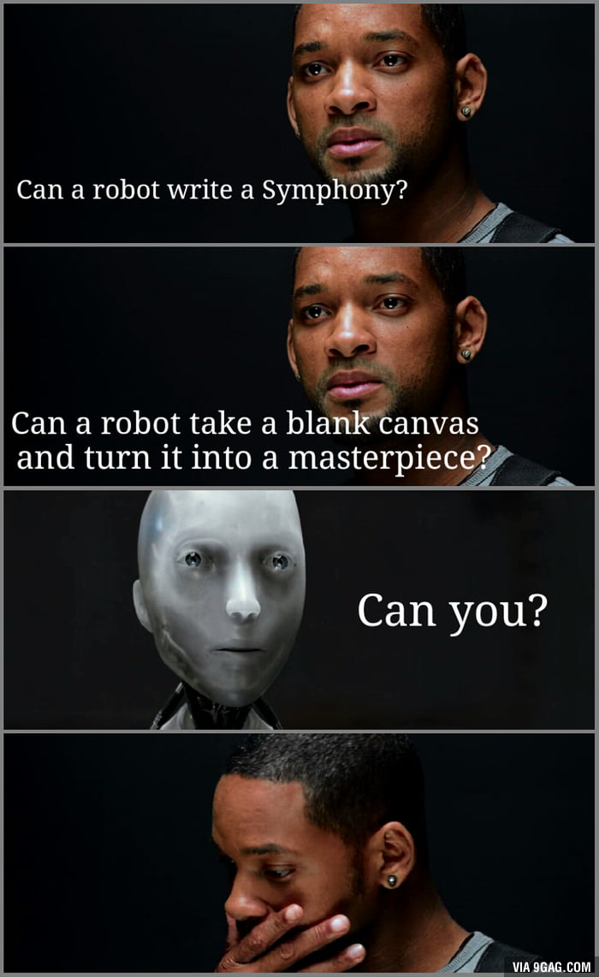


Introduction
Can a robot write a symphony?
GPT-3 : YES
2006
Notes:
To begin with, I'd like to quote a famous line from the movie “I, Robot” which reads “Can a robot write a symphony? “
In addition, the actor asked “…”
It might be hard to answer in 2006,
but fifteen years later, GPT-3 can confidently reply them: YES

Slide 5
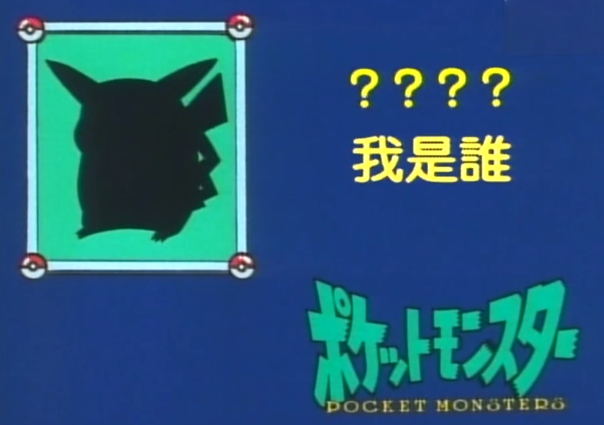

Guess who I am🧐
Notes:
Next, let's have a game —— guessing whether I am a robot or human
OK now you have your choice, keep it a secret. I'll reveal the answer at the end of this talk

Slide 6
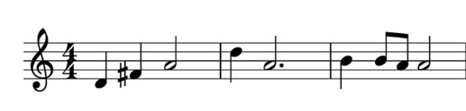
Review
Audio Pattern Recognition
Acoustic scene classification
Audio tagging
Sound event detection
…
Music comprehension ?
Natural Sound
Music
Notes:
Then let's review what I've talked before, audio pattern recognition. Last time I introduced three kinds of recognition tasks: ()()().
This time I 'll show another branch of audio pattern recognition, which is Music comprehension
Let's compare the previous ones with the new one:
The former ones focus on natural sound processing, while the latter on music
As you can see music will have more regular patterns and restrictions than natural sound
In this talk we mainly talk about classical music, in particular piano performances

Slide 7
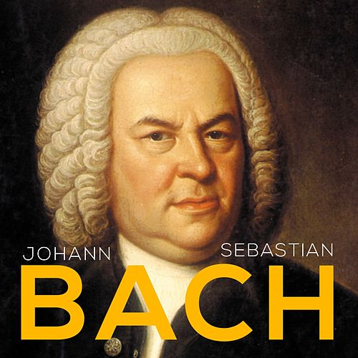
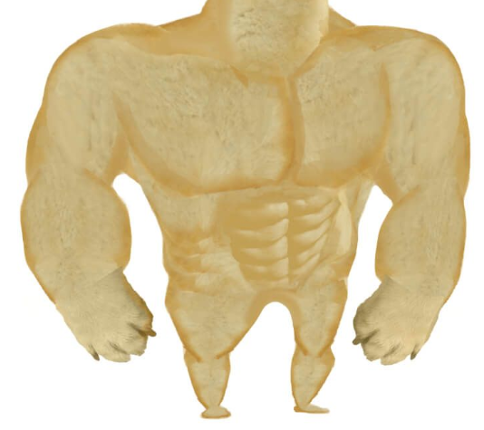
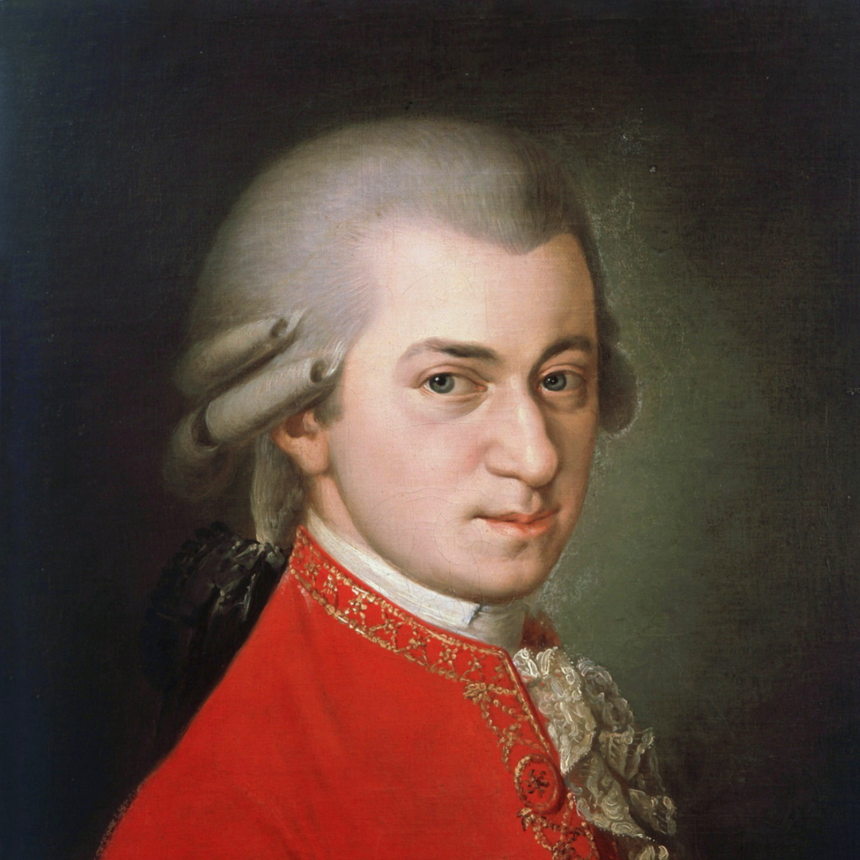
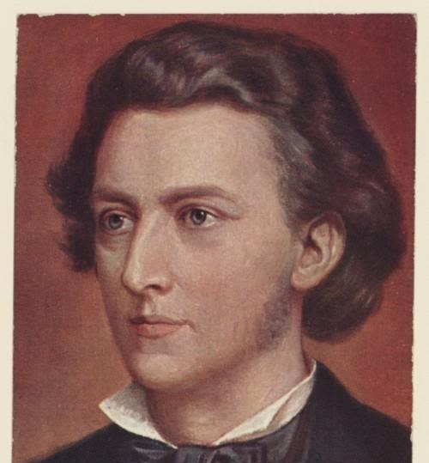
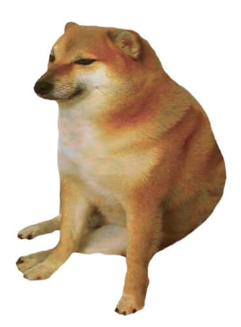
Classical Music
Pre Baroque
Baroque era
Classical era
Romantic era
Contemporary era
Religious purpose
MOZART
Separate from religion
CHOPIN
emotional elements & romanticism
…
Notes:
Here I'll quickly go through the history of classical music
The oldest ones are () and (), in this period music was mainly for religious purpose, in which we have bach
Next is classical era, when music gradually separate from religion, in which we have mozart
Then Romantic era, music began to emphasize emotional elements and romanticism, in which we have Chopin
Last Contemporary era, in which we have no famous musician
and If we illustrate these men's strength...

Slide 8

Classical Music in danger?
Maybe AI can help
What if AI learns all the master pieces in history?
Lack of resources like piano transcripts
Notes:
A natural question is, are classical music in danger?

Slide 9
Outline
Introduction
Learning to record
Learning to compose
Conclusion

Slide 10
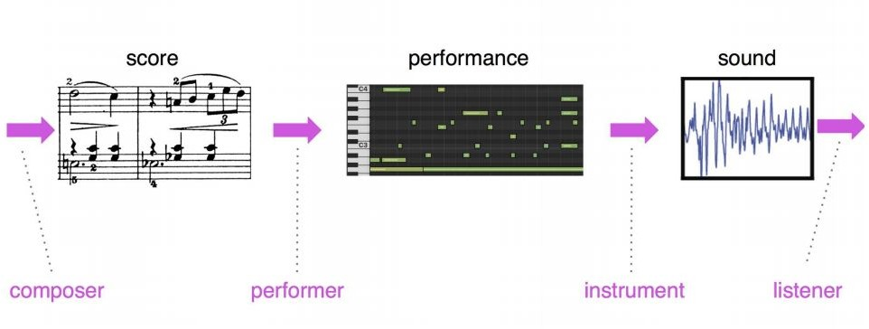
Raw representations in music and language
Language
text
speech
Music
(Image from Simon & Oore, 2016)
Notes:
First you must know the (title)
you can see they are similar
in language ...
in music ...
here the intermediate one is what we process in music comprehension

Slide 11
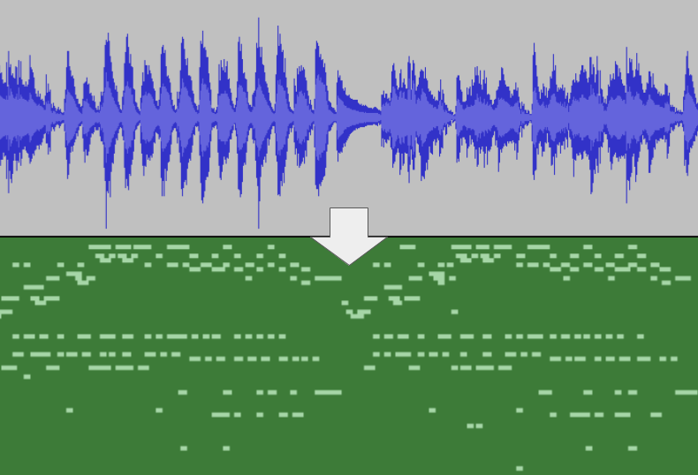
Music transcription
Transform a raw waveform to MIDI file
Why MIDI instead of
Q1 : Raw waveform?
Redundancy
Q2 : Only note and duration?
symbolic music representation:
Note(音符) on
Note off
Velocity
…
Score(曲谱) player:
MIDI recording:
Notes:
And the intermediate one is called MIDI, a symbolic music representation
Music transcription is transforming a raw waveform to MIDI files, in which there are events like ()()() etc
Why we use MIDI for computer music comprehension
Compare two kinds of recordings
...
Yes, Timing and dynamics represented as velocity is what makes music enchanting

Slide 12
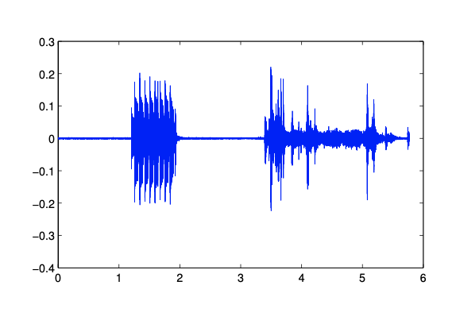
Music transcription
Similar to polyphonic sound event detection
Common: Detecting onset and offset
Music transcription in addition predicting:
Pitch(音高)
Velocity
Further complicated when note energy decays
phone
printer
Tips: Pitch(音高) & Note(音符)
Certain Notes are in specific Pitches
Notes:
Read...in case you forget...
Velocity capture the speed of pressing a key, which is directly related to how loud the note sounds.
Imagine you pressing a note on a piano, the amplitude gradually decreases and the sound becomes weaker and weaker
Here is a little tip about Pitch and Note: In case you know nothing about music theory, … , sometimes we do not differentiate them

Slide 13
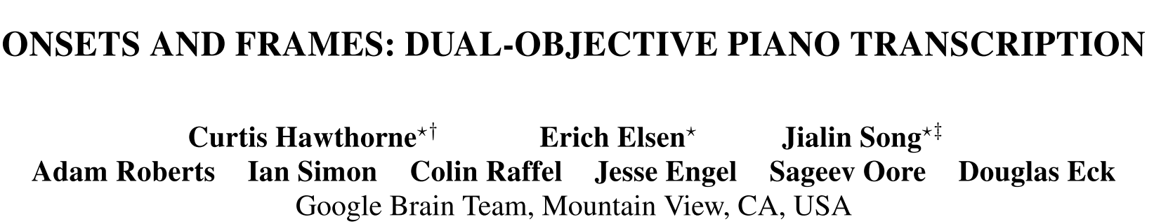
International Society for Music Information Retrieval Conference, ISMIR 2018
Notes:
A prevailing piano transcription approach called

Slide 14
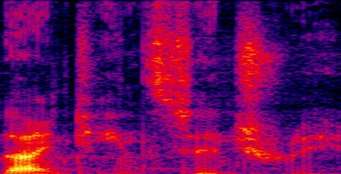
Automatic Music Transcription(AMT)
Sigtia el TASLP 2016
Acoustic Model
Input:
Framewise spectrogram
Output:
Probability of pitches in the frame
Language Model
Input:
Sequence of pitches probability
Output:
Next frame prediction
Notes:
Classical model

Slide 15
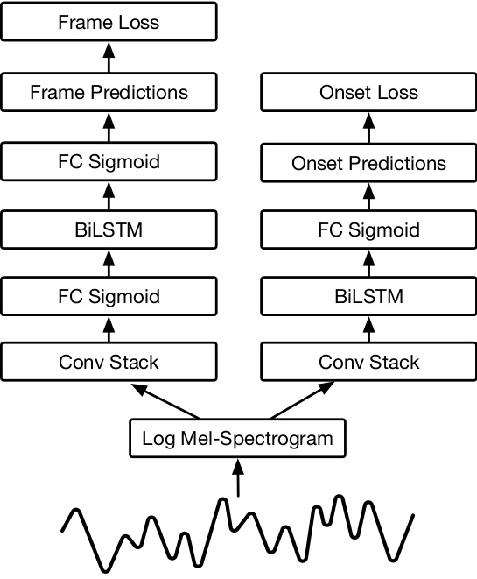
Model configuration
framewise note activation detector
onset detector
Separate two modules:
Onset frame prediction
Other frame prediction
Onset prediction privileged
Only when there is an onset,
there can be an offset
Notes:
They take advantage of the significance of onset frames by training a dedicated note onset detector and using the raw output of that detector as additional input for the framewise note activation detector

Slide 16
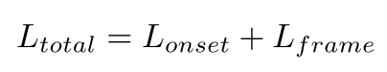
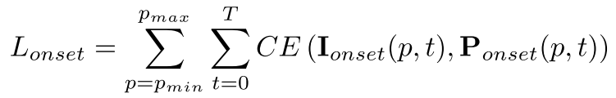

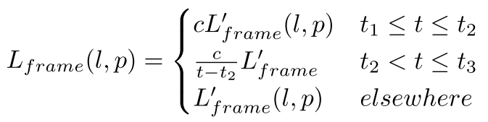
Loss function
Loss:
Onset Loss:
Frame Loss:
Pitch
Frame
Notes:
The author gives more weight in framewise prediction to the beginning frames after onset

Slide 17
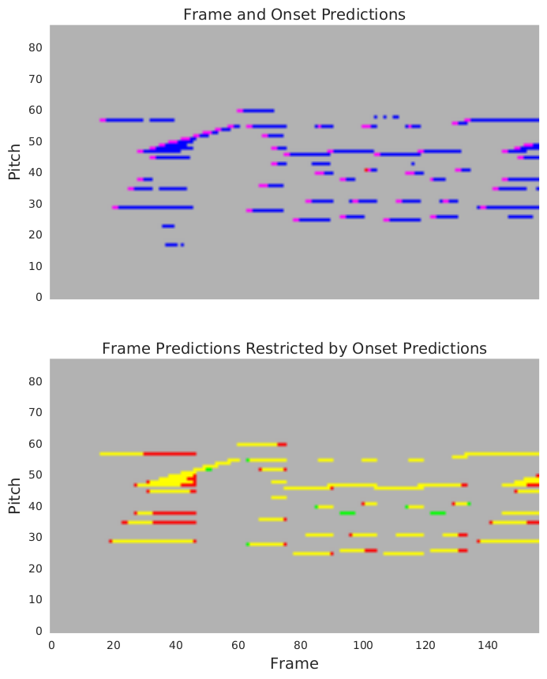
Analysis
Red: Onset Prediction
Blue: Frame Prediction
Red: Ground Truth
Yellow: Ground Truth &
Prediction
Green: (Wrong)Prediction
Notes:
First: method without red arrow which gives privilege to onset frame
We can see in most cases, ... while in several cases ...

Slide 18
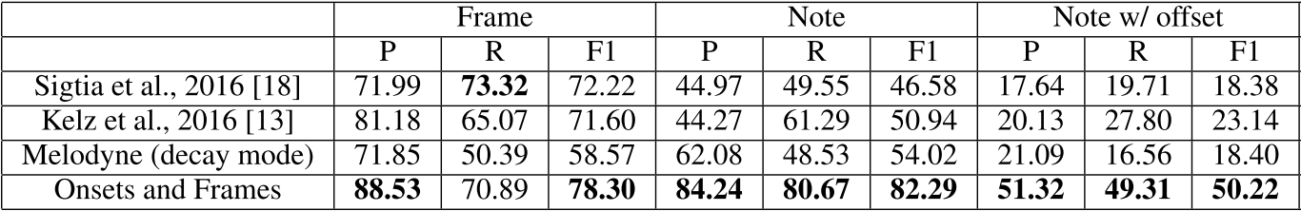
Experiment results
Frame
Note
Note with offset
Notes:
...
We can see in several cases there are even more than 100% increase

Slide 19
Example
Input Audio
Transcription
Mozart Sonata K. 331, 3rd movement
Input Audio
Transcription
Chopin Etude Op. 25 No. 3

Slide 20
Outline
Introduction
Learning to record
Learning to compose
Conclusion

Slide 21
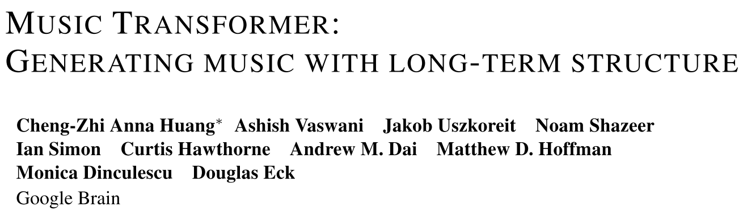
ICLR 2019

Slide 22
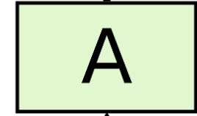
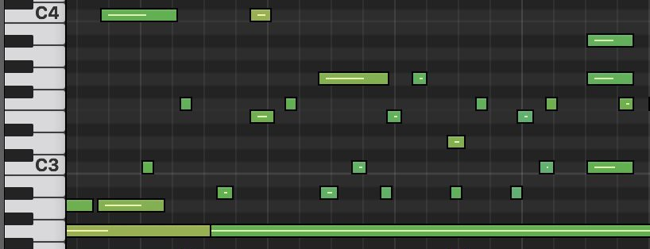
Prior work Performance RNN (Simon & Oore, 2016)
Music Language model:
h_{t}
h_{t}
Note on
128 events
A
X
Note off
128 events
t
388 dim
Note Velocity
Advance clock
32 events
100 events
One-hot encoding
Notes:
Recall a traditional RNN autoregressive model performance RNN, they encode the MIDI frames as a 388 dimension one-hot vector
A typical 30-second clip might contain ~1200 such one-hot vectors.

Slide 23
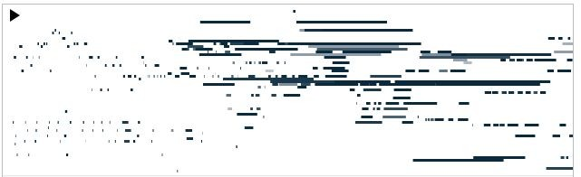
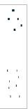
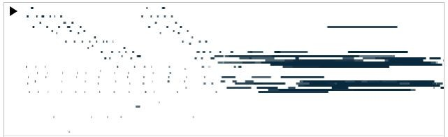
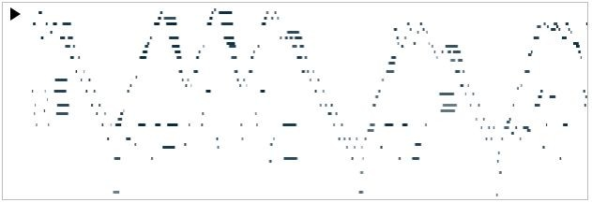
Continuations to given initial motif(主题)
Given
^{motif} RNN-LSTM
Transformer
Music Transformer
Notes:
Let me give some examples to illustrate the drawbacks of RNN and vanilla transformer
Given a motif fragment from Chopin Etude piece
...
...
...
we can see in the MIDI graph, the former two models fails capture long-term structure and repeat mechanically

Slide 24
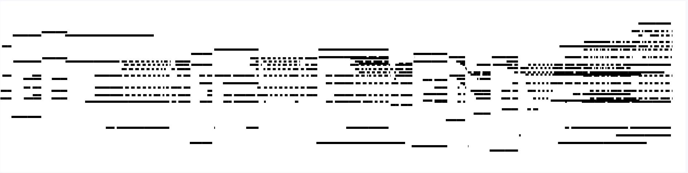
Self-Similarity in Music
Motifs repetitions with gaps in between
Notes:
The self-similarity in classical music is the intuition of using transformer.
We can see from the graph, there are motifs repetitions with gaps in between

Slide 25

Sample from Music Transformer
Different color refers to different attention heads

Slide 26

Attention: a weighted average
NoteOn60
TimeShift20
NoteOn62
TimeShift90
NoteOff62
NoteOff60
TimeShift90
No structure which came before or after
NoteOn60
TimeShift20
NoteOn62
TimeShift90
NoteOff62
NoteOff60
TimeShift90
Notes:
as we know, Attention is a weighted sum of past history
However, classical music generation relies heavily on relative positions.
This problem was later solved by transformer XL and XLNet, etc. but when this paper was published, there are no transformer xl or xlnet.

Slide 27

Convolution:
Different linear transformations by relative position.
TimeShift100
TimeShift100
TimeShift30
NoteOn60
TimeShift20
NoteOn62
TimeShift90
NoteOff62
NoteOff60
TimeShift90
TimeShift100
TimeShift100
TimeShift30
NoteOn60
TimeShift20
NoteOn62
TimeShift90
NoteOff62
NoteOff60
TimeShift90
Notes:
On the other hand, convolution could capture different linear transformations by relative position
we have filters moving around to capture relative distances

Slide 28

Relative attention (Shaw et al, 2018)
Multihead attention + convolution?
TimeShift100
TimeShift100
TimeShift30
NoteOn60
TimeShift20
NoteOn62
TimeShift90
NoteOff62
NoteOff60
TimeShift90
TimeShift100
TimeShift100
TimeShift30
NoteOn60
TimeShift20
NoteOn62
TimeShift90
NoteOff62
NoteOff60
TimeShift90
Notes:
This is why Music transformer can capture a kind of translational invariance and carry it forward

Slide 29
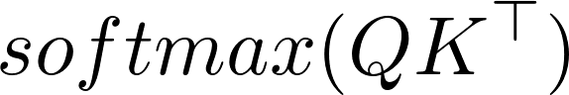
Closer look at attention
Sequence length = 3
Self-similarity
Notes:
This is the vanilla transformer attention, in which the grey dots represents the masked upper triangular(cuz in a sequence a token cannot see the tokens behind it)

Slide 30

Closer look at relative attention
S_{rel}
Modulated by relative positions
0
-1
0
-2
-1
0
Self-similarity
Similarity between positions
Notes:
This is the transformer with relative attention.
On the right each color corresponds to a different relative distance

Slide 31
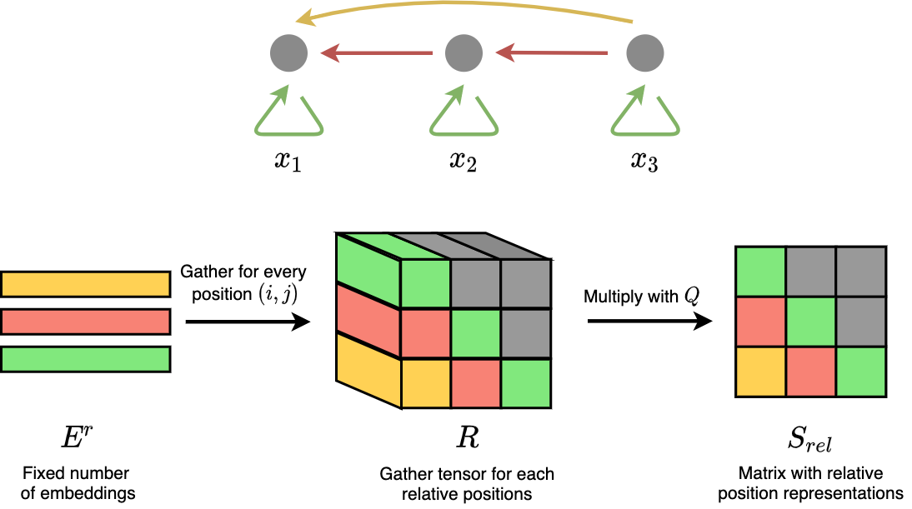
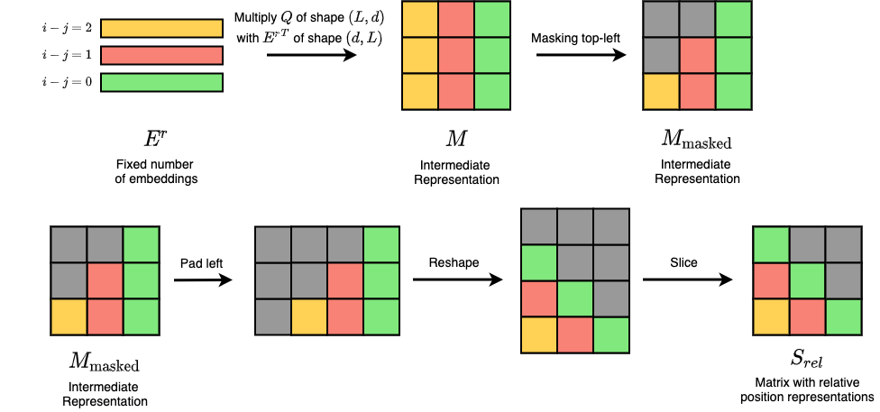
Calculate S_{rel} =Qf(E_{rel} ) (original)
Notes:
We can regard the sequence as a backward fully connected graph, each color represents a relative distance and has its corresponding embedding
here yellow...orange...green

Slide 32


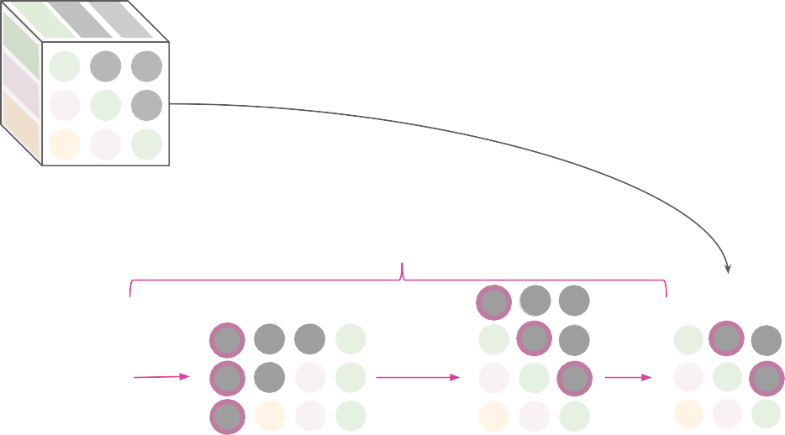




Skewing to reduce relative memory from O(L²D) to O(LD)
Per layer, L=2048, D=512
0
Previous work
O(L²D): 8.5 GB
-1 0
-2 -1 0
Relative embeddings
_{E}r
i
Multiply by Q
q
Our work
O(LD): 4.2 MB
Skew
_{QE}rT
_{S}rel
Pad
Reshape
Slice
Directly multiply by Q
i_{q}
Notes:
The space consumption is tolerable in machine translation when there are just under 100 tokens
However, it's impractical for music generation to have such a intermediate tensor of space complexity O(L square D), cuz there are around 2000 tokens in one minute music.
As you can see, the memory cost is unacceptable.
The author used a simple trick called skew operation and have reduced the memory usage significantly

Slide 33
Calculate S_{rel} (new)
i-j (relative)
i
(absolute)
i (absolute)
i
(absolute)
Notes:
first...
Note that in this matrix, the y axis is relative index, and x axis is absolute index
we want a matrix having absolute index in both x and y axis
you may wonder how this reshape come

Slide 34
Skewing

Slide 35
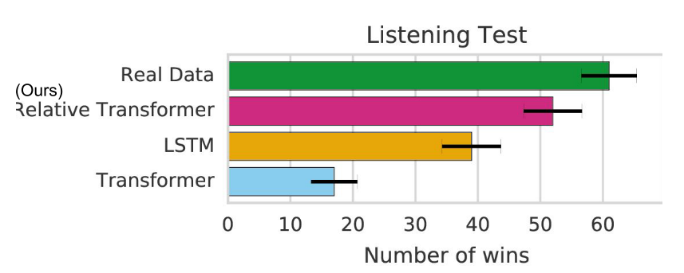
Human evaluation
Listen and tell which one is more “human”
3 models, 10 samples each and 10 real data
60 pairwise comparisons
Notes:
They asked human to tell which one of the two performances are more “human” against “AI”

Slide 36
Outline
Introduction
Learning to record
Learning to compose
Conclusion

Slide 37
Conclusion
Music transcription
Acoustic model Language model
Pay more attention to onset frame prediction
Music transformer
Modeling self-similarity in music
Skewing to reduce relative computational complexity
When will AI take their jobs?
Notes:
`

Slide 38
Guess who I am🧐

Slide 39

Guess who I am🧐

Slide 40
Thanks!

